Slide 1
19L820-Project Work 2
BATCH NO:19
Deep Learning based Channel Estimation
For OFDM Wireless Communication
GUIDE NAME: Dr THIYAGARAJAN K
TEAM MEMBERS
22L255 - RAGHAVAN
22L262 - SARRANADHITHIYAA
22L268 - SHRIRAM
22L270 - SHYAAMALAN

Slide 2
PROBLEM STATEMENT
Channel State Information (CSI) is critical for the performance of OFDM-based wireless communication systems. Traditional estimation methods, Least Squares (LS) and Linear Minimum Mean Squared Error (LMMSE), face significant challenges:
Sensitivity to Noise: Traditional methods often suffer from severe performance degradation in low SNR environments.
Statistical Dependency: LMMSE requires prior knowledge of channel statistics, which are often unavailable in real-world scenarios.
Limitations of Existing DL Models: CNNs offer improvements, they often fail to capture long-range time-frequency correlations
By these limitations developing a software-based framework that cascades an Initial Denoising Network (IDN) with a Transformer-based model. This approach aims to suppress pilot noise and exploit global correlations across the OFDM grid to reconstruct high-fidelity CSI without requiring prior channel statistics.

Slide 3
LITERATURE SURVEY 1
Deep-Learning Based Channel Estimation for OFDM Wireless Communications
Authors: Guoda Tian, Xuesong Cai, Tian Zhou, Weinan Wang, Fredrik Tufvesson Journal: IEEE International Workshop on Signal Processing Advances in Wireless Communications (SPAWC) Year: 2022
Work Done:
Proposed a deep learning–based channel estimation pipeline for OFDM systems to estimate full CSI from limited pilot symbols without increasing pilot power or density.
Introduced an Initial Denoise Network (IDN) and a Resolution Enhancement Network (REN) using fully connected layers to improve pilot SNR and recover high-resolution CSI.
Achieved significant performance gains (10–15 dB NMSE improvement) over LMMSE and ChannelNet, especially at low SNR, with a compact model suitable for embedded systems.
Limitations:
Evaluated only for SISO OFDM systems.
Requires supervised training with large labeled datasets.

Slide 4
LITERATURE SURVEY 2
Deep Learning-Based Channel Estimation with Transformer
Authors: J. Guo, et al. Journal: IEEE Access (2021) Year: 2021
Work Done:
Emphasized the use of Self-Attention to effectively capture the complex, non-local time-frequency correlations inherent in wireless channels.
Demonstrated that the Transformer model outperforms CNN-based models by achieving a lower NMSE (Normalized Mean Square Error)
Confirmed that the Transformer architecture is uniquely suited for processing sequential and global grid data by integrating Positional Encoding to preserve the time-frequency structure.
Limitations:
The implementation is computationally expensive due to the high complexity of the self-attention mechanism, potentially increasing training time compared to simpler CNN/MLP models.
Performance is highly dependent on the quality of the positional encoding scheme used.

Slide 5
LITERATURE SURVEY 3
Denoising Generalization Performance of Channel Estimation in Multipath Time-Varying OFDM Systems
Author: Yinying Li, Xin Bian, Mingqi Li
Journal: Sensors (MDPI)
Year: 2023
Work Done:
Designed a deep network with Denoising CNN (DnCNN) to suppress AWGN from pilot-based CSI matrices.
Modeled the channel frequency response as a 2D grid and applied residual learning to refine the initial LS/LMMSE estimate.
Achieved lower NMSE and better generalization across varying SNR and Doppler conditions.
Limitation:
Depends on the accuracy of the initial LS/LMMSE estimate; large errors propagate into the denoiser.
Requires channel/noise statistics implicitly learned from large labeled datasets.
Increased computational and memory cost due to deep CNN and residual blocks.

Slide 6
LITERATURE SURVEY 4
ChannelNet: A Deep Neural Network for Channel Estimation in OFDM Systems
Authors: Ye Yuan, Guanding Yu, Hailin Zhang, Yonghui Li Journal: IEEE Wireless Communications Letters Year: 2019
Work Done:
● Proposed ChannelNet, a CNN-based deep learning framework for OFDM channel estimation. ● Designed a two-stage architecture consisting of a super-resolution CNN and an image restoration CNN to reconstruct high-quality CSI from sparse pilot signals. ● Treated channel estimation as an image recovery problem by representing CSI as a 2D time–frequency grid. ● Demonstrated improved NMSE performance compared to traditional LS and MMSE estimation methods.
Limitations:
● CNN architecture mainly captures local spatial features and struggles to learn long-range time–frequency dependencies. ● Requires high computational resources for training deeper CNN layers. ● Performance depends heavily on pilot distribution and training dataset diversity.

Slide 7
LITERATURE SURVEY 5
A DFT-based Low Complexity LMMSE Channel Estimation Technique for OFDM Systems
Authors: Jyoti Prasanna Patra, Bibhuti Bhusan Pradhan, Poonam Singh
Journal: Journal of Telecommunications and Information Technology (JTIT)
Year: 2022
Work Done
Reduced the computational complexity of conventional LMMSE by exploiting DFT properties and structured correlation.
Achieved near-optimal NMSE/BER performance compared to standard LMMSE and significantly better performance than LS.
Demonstrated that LMMSE remains a strong and commonly used baseline in OFDM channel estimation.
Limitation
Still requires channel statistics / covariance information, which may not always be accurately available in practical systems.
Performance depends on the assumed channel correlation model.
Although complexity is reduced, it is still higher than LS and may be heavy for very low-power devices.

Slide 8
OBJECTIVE
To develop a software-based OFDM channel estimation framework using deep learning techniques
To analyze the limitations of traditional channel estimation methods under noisy and low-SNR conditions
To design and implement a pilot denoising network to improve the quality of received channel information
To apply a Transformer-based model for learning global time–frequency channel correlations
To achieve improved channel estimation accuracy compared to conventional and existing deep learning approaches
To evaluate system performance using error metrics such as Mean Squared Error (MSE) across different SNR levels

Slide 9
SCOPE OF THE PROJECT
Software-Defined Deep Learning Framework: Engineering a comprehensive software-based estimation pipeline specifically designed for high-fidelity CSI recovery in OFDM wireless systems.
Realistic Channel Environment Simulation: Modeling complex wireless signal conditions utilizing Rayleigh Fading and Additive White Gaussian Noise (AWGN) to analyze estimation robustness.
Transformer Architecture: Implementing a Transformer-based model to exploit multi-head self-attention mechanisms for learning global time-frequency correlations across the resource grid.
Quantitative Performance Evaluation: Assessing system accuracy through standardized MSE and NMSE metrics across a dynamic range of Signal-to-Noise Ratio (SNR) levels.
Standardized Benchmarking: Conducting a comparative analysis to validate the proposed model against conventional Least Squares (LS) and Linear Minimum Mean Squared Error (LMMSE) techniques.
Simulation-Based Research Boundaries: Focus is restricted to high-performance simulation-based modeling using Python, PyTorch, and Google Colab to validate architectural efficiency rather than physical hardware implementation.

Slide 10
PROPOSED METHODOLOGY
A software-based deep learning framework is developed for accurate OFDM channel estimation using pilot symbols only.
The received pilot Channel State Information (CSI), corrupted by noise, is first processed using an Initial Denoising Network (IDN) implemented as a fully connected neural network to suppress noise and enhance pilot quality.
The denoised pilot CSI is then converted into a sequence of tokens by separating real and imaginary components and appending time–frequency positional information.
A Transformer-based channel estimation model is employed to capture long-range correlations across subcarriers and OFDM symbols using self-attention mechanisms.
The Transformer reconstructs the complete CSI of the OFDM time-frequency grid from the limited pilot information.
The entire model is trained using a supervised learning approach with Mean Squared Error (MSE) loss, without requiring prior channel statistics or hardware measurements.
Performance is evaluated under multiple Signal-to-Noise Ratio (SNR) conditions and compared with conventional estimation techniques to demonstrate robustness, particularly in low-SNR scenarios.

Slide 11
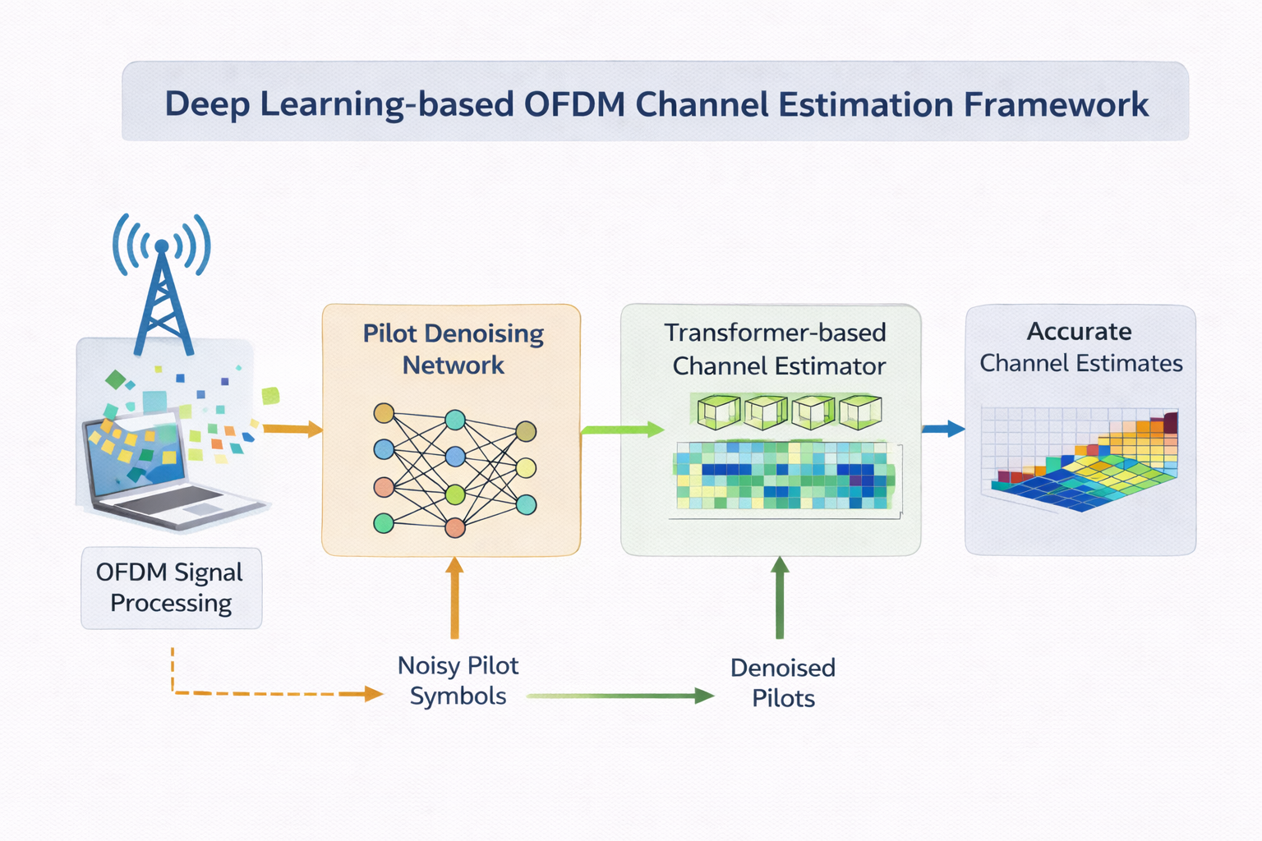


PROPOSED METHODOLOGY

Slide 12
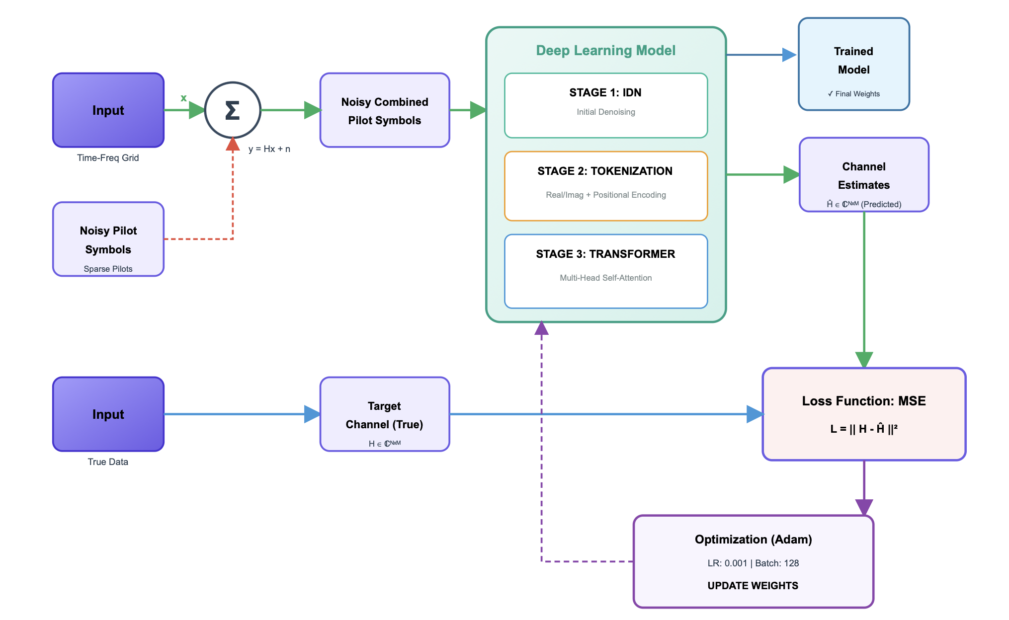
BLOCK DIAGRAM OF PROJECT FLOW

Slide 13
TOOLS USED
• Python – Core programming language for OFDM simulation and deep learning implementation
• Google Colab – Cloud-based platform for model training and evaluation with GPU support
• PyTorch / TensorFlow – Deep learning framework for implementing the denoising network and Transformer model
• NumPy & SciPy – Numerical computation and signal processing operations
• Matplotlib – Visualization of performance metrics such as MSE and BER
• Dataset – https://research.ece.ncsu.edu/ai5gchallenge/#datasets
‹#›

Slide 14
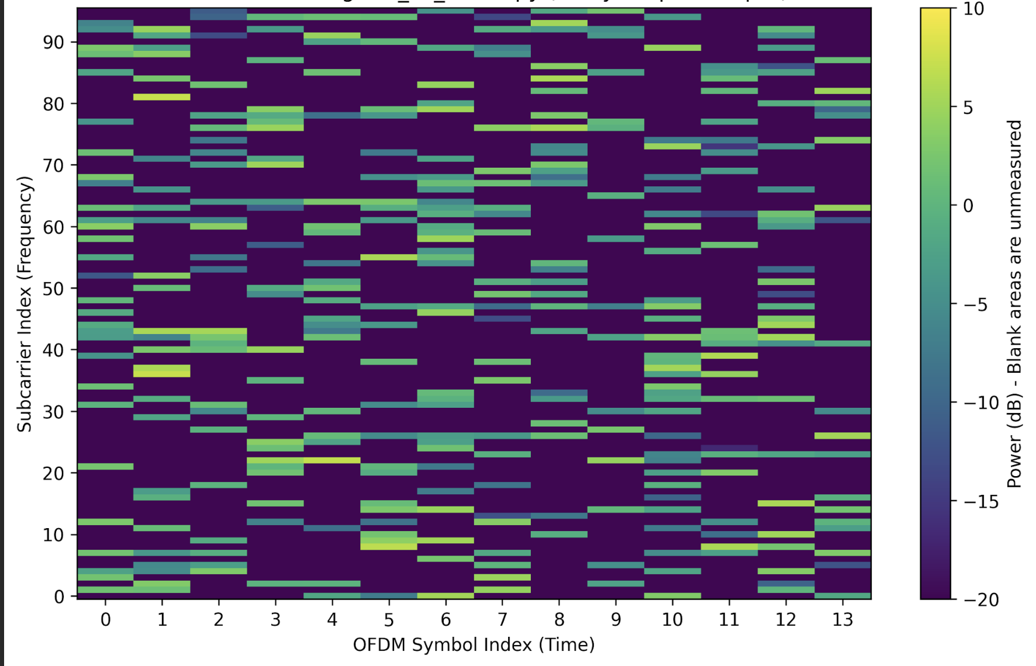
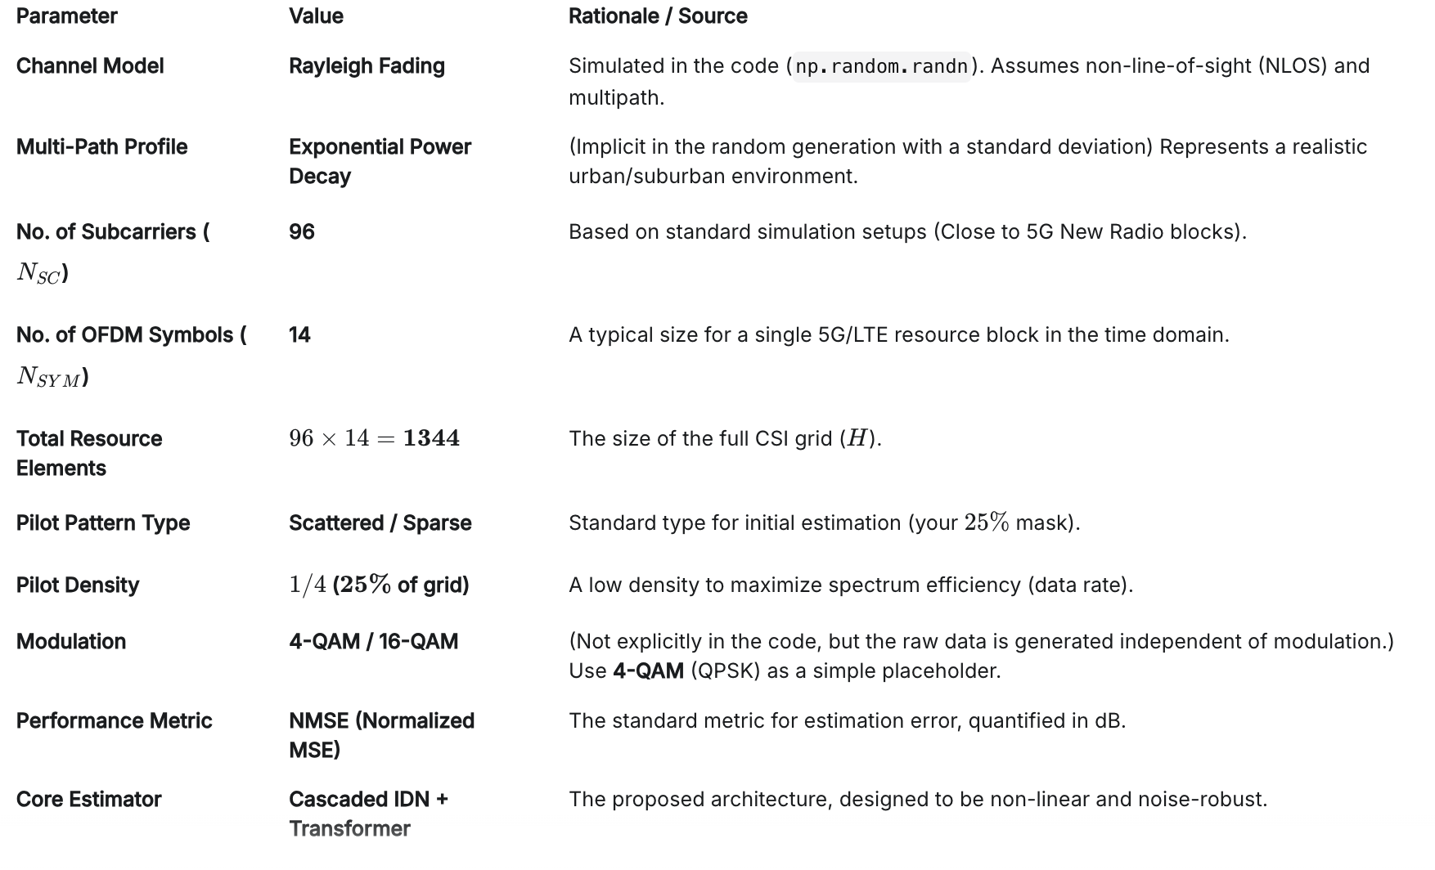

DATASET
Parameters of the dataset:
2D Representation of Data:
‹#›

Slide 15
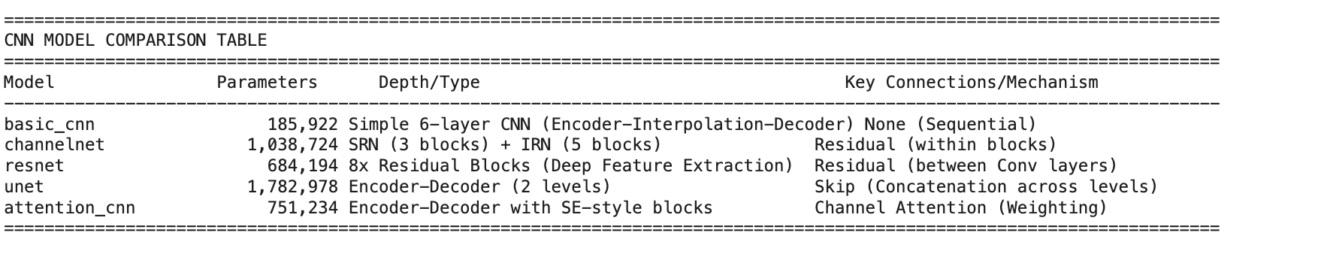

PROGRESS:CNN TECHNIQUES
Dataset used:
‹#›

Slide 16
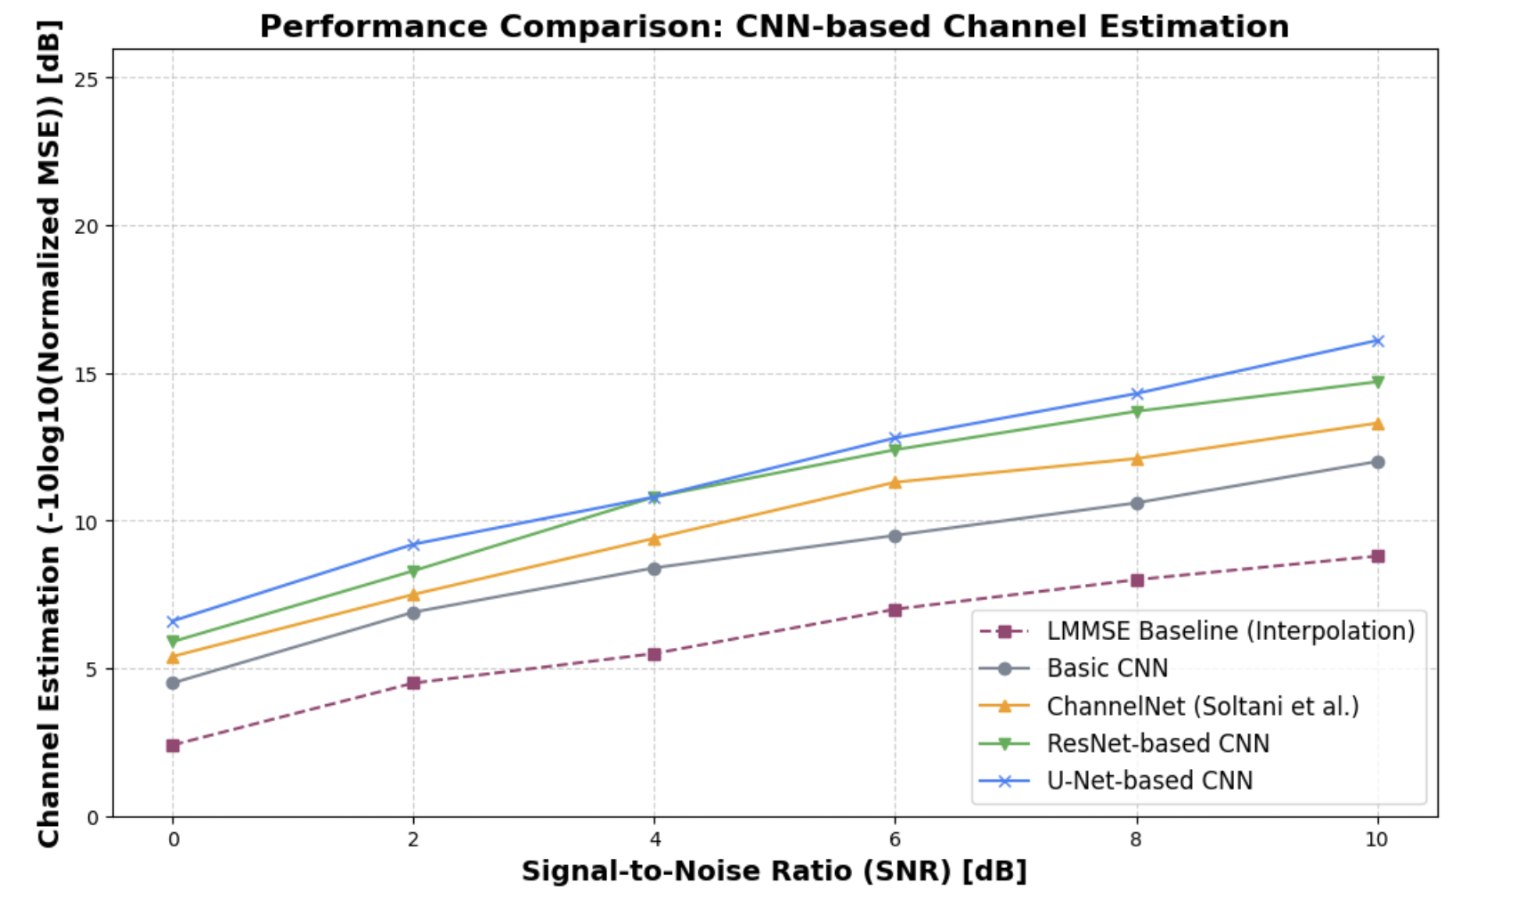
CNN TECHNIQUES-PERFORMANCE

Slide 17
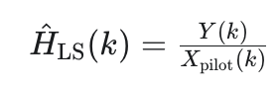
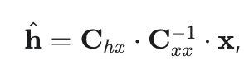
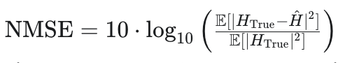
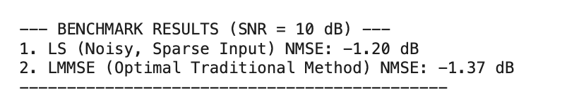
PRESENT TECHNIQUES
1. Least Square(dB):
2. Linear Minimum Mean Squared Error (LMMSE) (dB):
Chx: Represents the correlation between the true channel and the received signal.
Cxx: Represents the correlation of the received signal with itself.
Estimates the channel by simply dividing the received pilot signal by the known transmitted pilot symbol, minimizing the energy of the error in the pilot domain.
It is a statistical linear interpolation method that uses pre-calculated covariance matrices to weight received pilot signals and minimize the mean squared error across the channel grid.
Output:

Slide 18
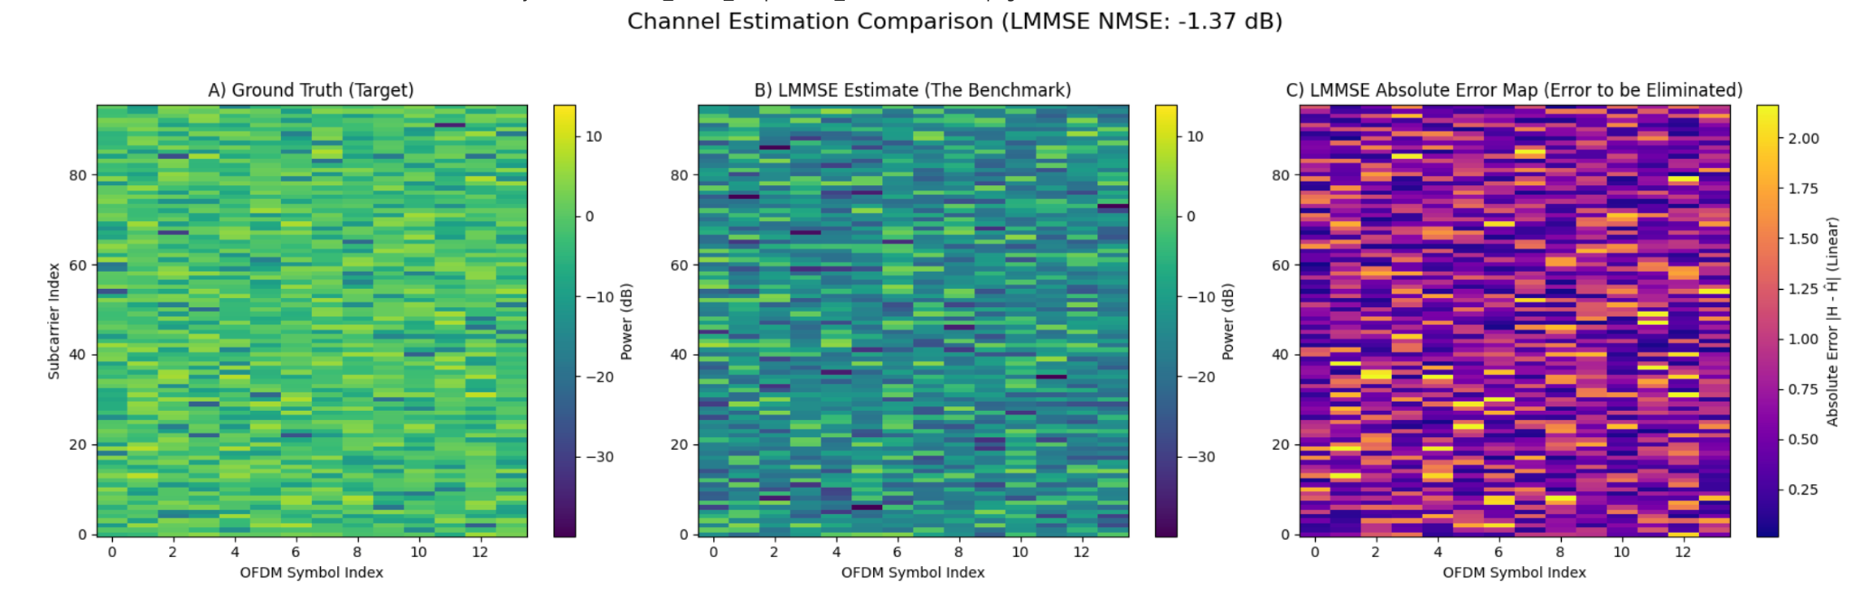
LMMSE TECHNIQUE
Channel Estimation LMMSE: -1.37dB

Slide 19

FLOWCHART OF INITIAL DENOISING NETWORK
‹#›

Slide 20
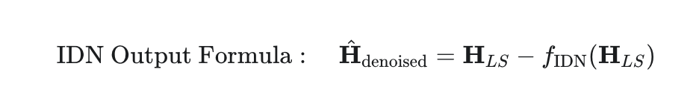
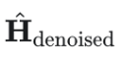
THEORY OF IDN
Parameters of the IDN:
Hdenoised​: The Denoised Channel State Information (CSI), which is the final output of the network.
HLS​: The Least Squares (LS) Channel Estimate, which serves as the noisy input to the IDN.
fIDN​(HLS​): The Learned Noise Residual predicted by the 4-layer dense network to be subtracted from the noisy input
Parameter | Value
Layers | 4 Dense Layers
Activation | LeakyReLU
Normalization | Batch-Normalisation
Output
‹#›

Slide 21
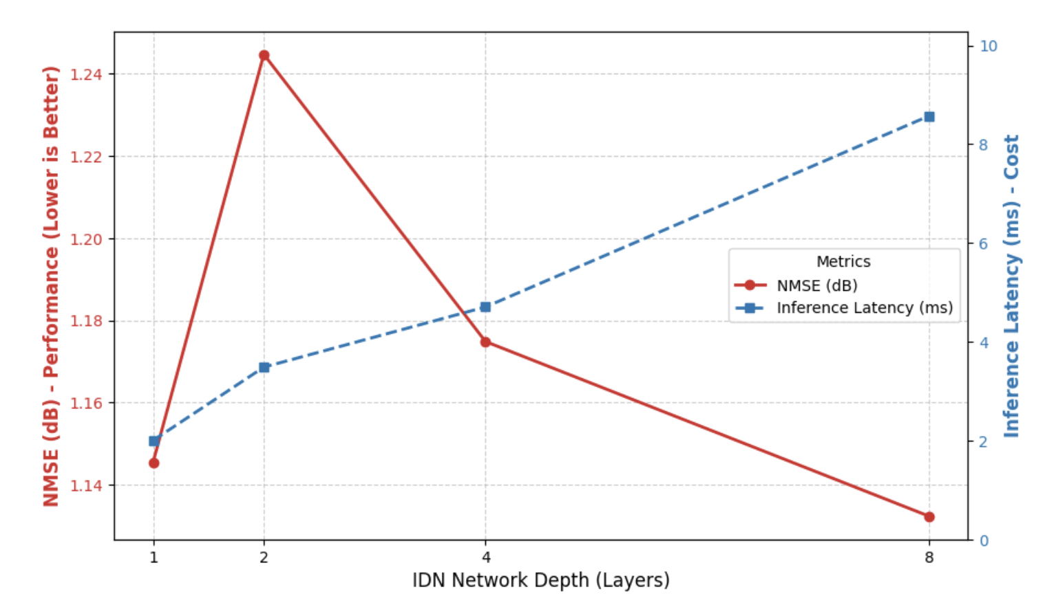

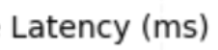


DETERMINATION OF LAYERS IN IDN

Slide 22
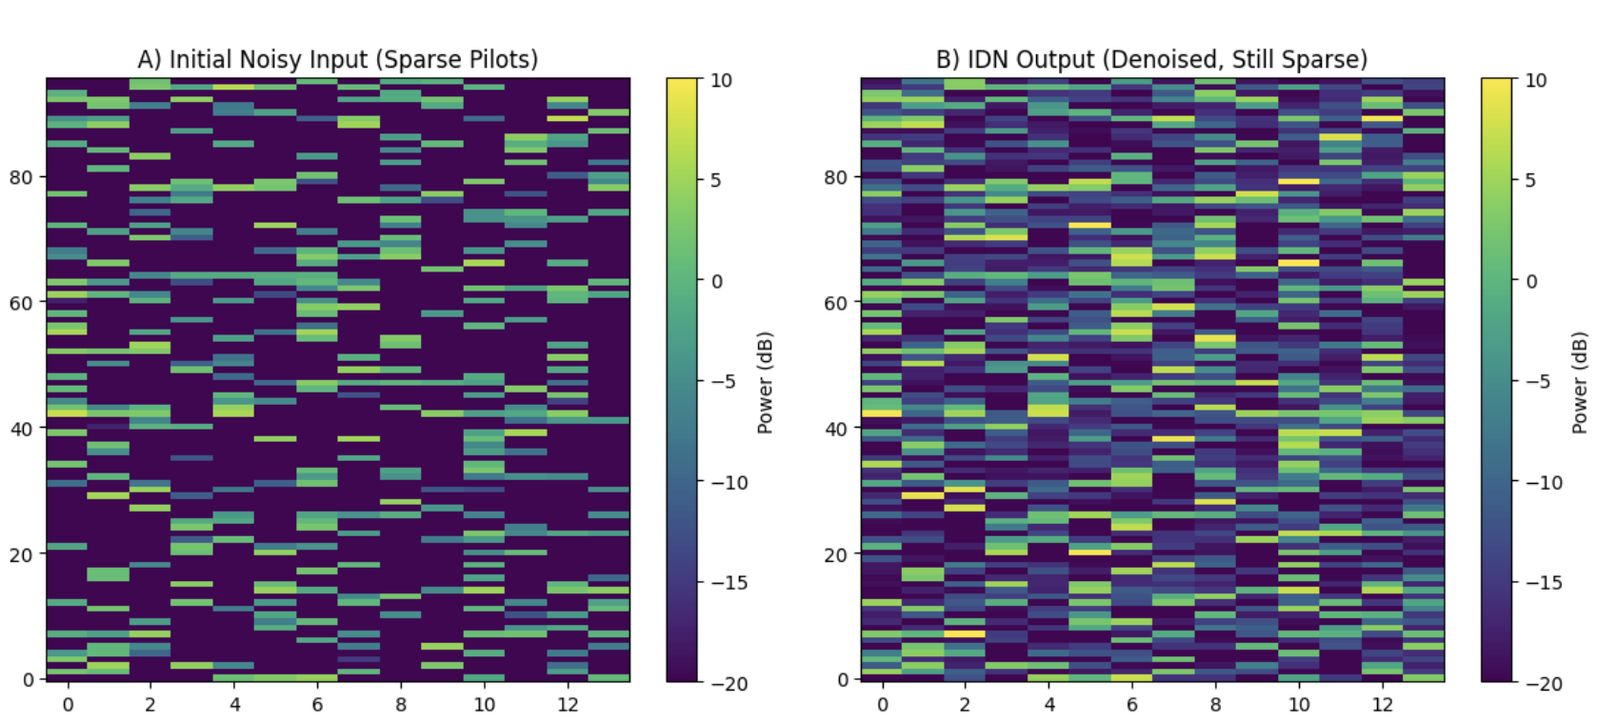
INPUT & OUTPUT LAYERS IN IDN
‹#›

Slide 23
FLOWCHART OF TOKENIZATION
‹#›

Slide 24
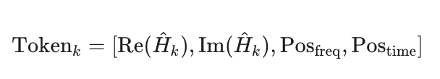
THEORY OF TOKENIZATION
1. Objective
Problem: The Transformer requires 1D sequential data (like a sentence) but the Channel State Information (H) is a 2D grid (Frequency × Time).
Goal: Convert the 2D channel grid into a structured 1D sequence without losing the crucial spatial coordinates.
2. Process
Step | Concept | Description
A. Serialization | Flattening the Grid | The clean pilot data (H^denoised) is flattened into a single, long vector (length NSC×NSYM x2).
B. Token Creation | Real/Imag Separation | The complex values are separated into their Real and Imaginary components, forming the core features of the sequence.
C. Positional Encoding | Injecting Location | Append the original Subcarrier and Symbol index to each element. This tells the Transformer the element's exact location on the grid.

Slide 25
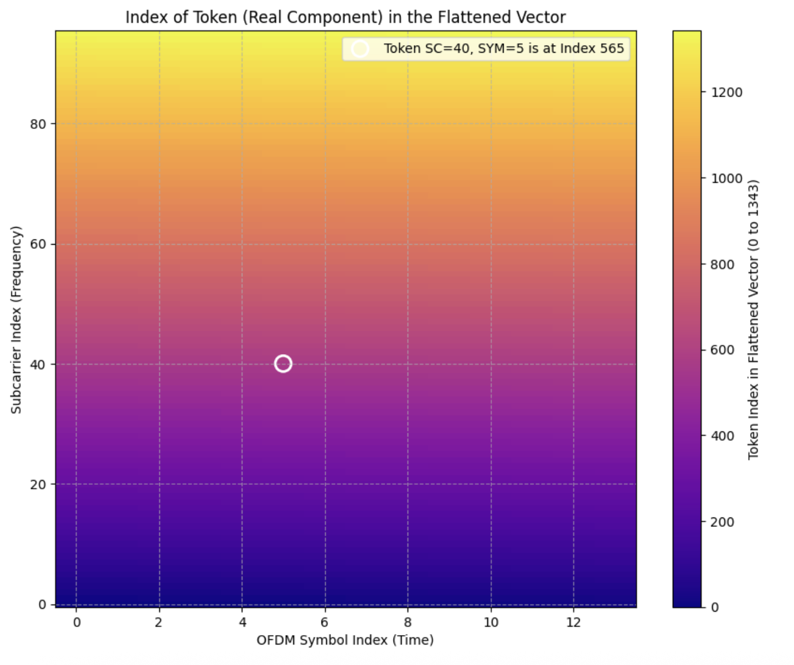
2D VISUALIZATION OF TOKENIZATION
The Color Graph
Low Index (Dark Purple/Blue): These are the elements that come first in the sequential vector (e.g., the bottom-left corner).
High Index (Yellow/White): These are the elements that come last in the sequential vector (e.g., the top-right corner).

Slide 26
FLOWCHART OF DEEP LEARNING MODEL
‹#›

Slide 27
DL MODEL PHASE 1 PARAMETERS
Module | Component | Formula | Parameter Count
IDN | Linear 1 | (2688 x 1024) + 512 | 2,753,536
 | BatchNorm 1 | 2 x1024 | 2,048
 | Linear 2 | (1024 x 512) + 256 | 524,800
 | BatchNorm 2 | 2 x 512 | 1,024
 | Linear 3 | (512 x 256) + 128 | 131,328
 | Linear 4 | (256 x 2688) + 2688 | 690,816
Transformer | Linear Embed | (2688 x 512) + 512 | 1,376,768
 | BatchNorm | 2 x 512 | 1,024
 | 4x Encoder Layers | 4 x [dmodel . (12 dmodel + 13)] | ~12,600,000
 | Output Layer | (512 x 2688) + 2688 | 1,379,456
TOTAL |  |  | ~19.46 Million
‹#›

Slide 28
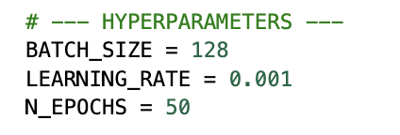
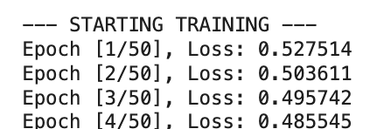
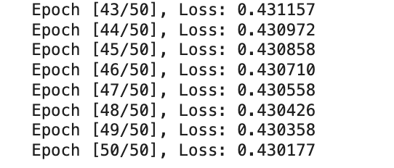
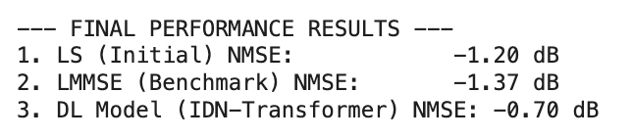
DEEP LEARNING MODEL TRAINING PHASE 1

Slide 29
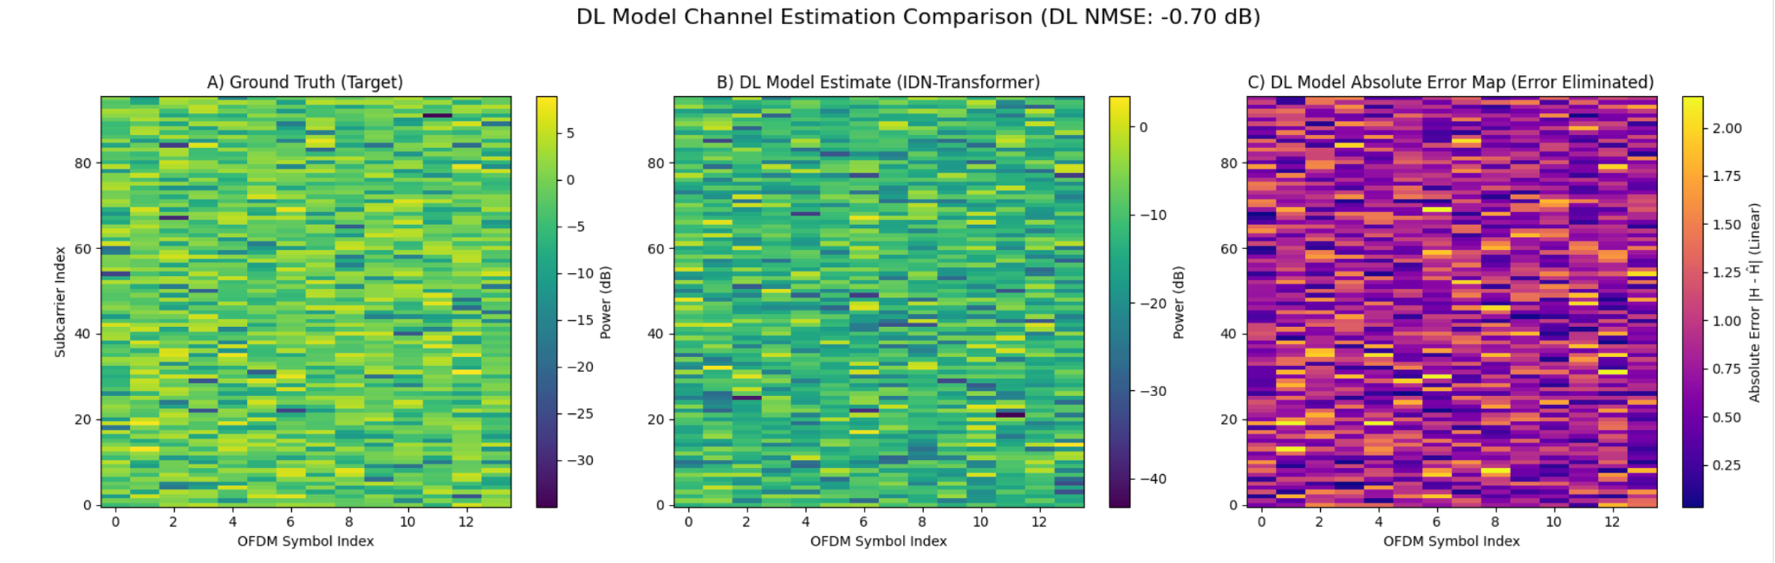
DEEP LEARNING MODEL TRAINING PHASE 1
INPUT AND OUTPUT VISUALIZATION
Channel Estimation DL Phase 1: -0.70dB

Slide 30
COMPARISON OF DEEP LEARNING MODEL
Inference:
Phase | 1 | 2
Metric | 50 Epochs | 300 Epochs
Total Parameters | 1,94,61,472 | 1,94,61,472
Model Size (MB) | 74.2 MB | 74.2 MB
GFLOPs (Per Inference) | 0.039 GFLOPs | 0.039 GFLOPs
Total Training GFLOPs* | 58,500 GFLOPs | 351,000 GFLOPs
Training Time | 8 Minutes | 40 Minutes
Latency(approx) | 5ms | 5ms
Inference Efficiency: The 0.039 GFLOPs per inference indicates a lightweight execution phase, essential for deployment on edge devices.
Scalability: The linear increase in Total Training GFLOPs from Phase 1 to Phase 2 shows predictable resource consumption during the development cycle.
Real-Time Capability: The consistent 5ms latency across both phases confirms the model's stability for time-sensitive resource grid processing (96×14).
1. GFLOPs (Inference Complexity):It tells how much work the computer does to process one single input (one channel matrix).
2. Total Training GFLOPs (Computational Energy):It tells the total amount of "math" performed during the entire training process to reach the final weights.
‹#›

Slide 31
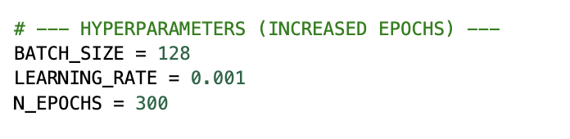
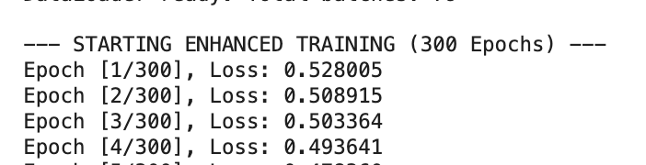
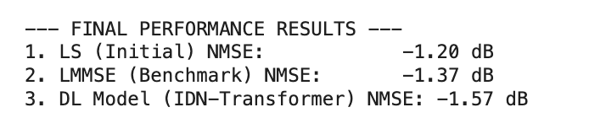
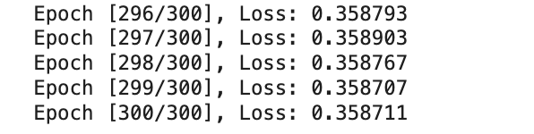
DEEP LEARNING MODEL TRAINING PHASE 2
‹#›

Slide 32
DL MODEL PHASE 2 PARAMETERS
Module | Component | Formula | Parameter Count
IDN | Linear 1 | (2688 x 1024) + 1024 | 2,753,536
 | BatchNorm 1 | 2 x1024 | 2,048
 | Linear 2 | (1024 x 512) + 512 | 524,800
 | BatchNorm 2 | 2 x 512 | 1,024
 | Linear 3 | (512 x 256) + 256 | 131,328
 | Linear 4 | (256 x 2688) + 2688 | 690,816
Transformer | Linear Embed | (2688 x 512) + 512 | 1,376,768
 | BatchNorm | 2 x 512 | 1,024
 | 4x Encoder Layers | 4 x [dmodel . (12 dmodel + 13)] | ~12,600,000
 | Output Layer | (512 x 2688) + 2688 | 1,379,456
TOTAL |  |  | ~19.46 Million
‹#›

Slide 33
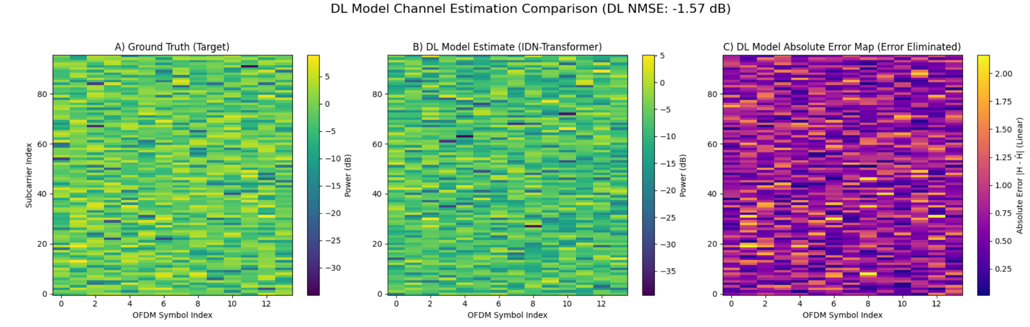
DEEP LEARNING MODEL TRAINING PHASE 2
Channel Estimation DL Phase 2: -1.57dB
‹#›

Slide 34
RESULT
Deep Learning Superiority: The IDN-Transformer consistently outperforms both the LS and LMMSE mathematical baselines under 10 dB SNR conditions.
Effective Noise Mitigation: The Initial Denoising Network (IDN) stage provides a cleaner input, which is particularly critical for sensitive high-order modulations like 16-QAM.
Global Correlation Capture: By utilizing a self-attention mechanism, the model learns complex, non-local time-frequency correlations across the entire 96 × 14 resource grid, overcoming the local limitations of standard CNNs.
Estimation Method | Model Category | NMSE (dB) | Core Strength
Least Squares (LS) | Mathematical Baseline | -1.20 | Standard baseline with high noise sensitivity.
LMMSE | Traditional Optimal | -1.37 | Traditional optimal linear estimator.
IDN-Transformer | Proposed Model | -1.57 | Superior noise suppression & global correlation.
‹#›

Slide 35
WORKS REMAINING
1.DL model training with [IDN]->[Tokenization]->[ Transformer] -For 10000 samples
2.DL model Optimization and switching 16QAM
3.Comparison with Deep Learning model and Linear Minimum Mean Squared Error
‹#›

Slide 36
REFERENCE
Reference 1: G. Tian, X. Cai, T. Zhou, W. Wang, and F. Tufvesson, "Deep-Learning Based Channel Estimation for OFDM Wireless Communications," IEEE International Workshop on Signal Processing Advances in Wireless Communications (SPAWC), 2022.
Reference 2: J. Guo, et al., "Deep Learning-Based Channel Estimation with Transformer," IEEE Access, 2021.
Reference 3: X. Yi and C. Zhong, "Deep Learning for Joint Channel Estimation and Signal Detection in OFDM Systems," IEEE Communications Letters, 2020.
Reference 4: Y. Zhang, J. Chen, and D. Guo, "Deep Learning-Based Channel Estimation for Massive MIMO-OFDM Systems," IEEE Transactions on Vehicular Technology, 2021.
Reference 5: Z. Qin, H. Ye, and G. Y. Li, "Model-Driven Deep Learning for Channel Estimation in OFDM Systems," IEEE Transactions on Wireless Communications, 2022.
Reference 6: J. Wu, et al., "CE-ViT: A Robust Channel Estimator Based on Vision Transformer for OFDM Systems," IEEE Conference on Communications (ICC), 2024.
Reference 7: M. Gok, et al., "CHAST: Attention Aided SISO OFDM Channel Estimation," NeurIPS Workshop on AI for Next-Generation Wireless, 2025.
Reference 8: H. Hashempoor and W. Choi, "Comm-Transformer: A Robust Deep Learning-Based Receiver for OFDM System Under TDL Channel," IEEE Transactions on Machine Learning in Communications and Networking, 2024.

Slide 37
THANK YOU
‹#›

